Slide 1
BANKINGMANAGEMENT SYSTEM
Under the Guidance of ,
Mrs. Indrakka Mali Mam
Submitted BY,
Sreeja M
Suma MR
Prashanth S
Sudha R
Kushal Sharma M

Slide 2
Introduction
The bank management system is an application for maintaining a person’s account in a bank. The system provides the access to the customer to create an account, deposit/withdraw the cash from his account, also to view reports of all accounts present. The following presentation provides the specification for the system.

Slide 3
Modules:
Account
Customer
Deposit
Withdraw
Transfer

Slide 4
Software Requirements
Spring boot
Rest API
MySql
Postman
Hardware Requirement
Windows 10 or above
RAM :4GB or above

Slide 5
Annotations:
1.@Entity
: The @Entity annotation specifies that the class is an entity and is mapped
to a database table. The @Table annotation specifies the name of the database
table to be used for mapping.
2.@Id :
The @Id annotation specifies the primary key of an entity and the @GeneratedValue provides for the specification of generation strategies for the values of primary keys.
3.@GeneratedValue
: Marking a field with the @GeneratedValue annotation specifies that a value will be automatically generated for that field. This is primarily intended for primary key fields but Object DB also supports this annotation for non-key numeric persistent fields as well.
4.@RestController :
It can be considered as combination of @Controller
and @ResponseBody annotations.
5.@Autowired
: Spring provides annotation-based auto-wiring by providing @Autowired annotation. It is used to autowire spring bean on setter methods, instance variable, and constructor.

Slide 6
6.@GetMapping
: It maps the HTTP GET requests on the specific handler method. It is used
to create a web service endpoint that fetches
7.@PutMapping
: It maps the HTTP PUT requests on the specific handler method. It is used to create a web service endpoint that creates or updates
8.@DeleteMapping
: It maps the HTTP DELETE requests on the specific handler method. It is used
to create a web service endpoint that deletes a resource.
9.@PostMapping
: It maps the HTTP POST requests on the specific handler method.
It is used to create a web service endpoint that creates
10.@Repository :
@Repository’s job is to catch persistence-specific exceptions and re-throw them as one of spring’s unified unchecked exceptions.
10.@Query
: The @Query annotation can only be used to annotate repository interface
methods. The call of the annotated methods will trigger the execution of
the statement found in it, and their usage is pretty straightforward.

Slide 7
11.@Transactional:
The @Transactional annotation is that specifies the semantics of the transactions on a method.
12.@Modifying :
The @Modifying annotation is used to enhance the @query annotation so that we can execute not only select queries,but also Insert,Update,Delete,and even DDl queries.
13.@Service
:It is used at class level. It tells the spring that class contains the business logic
14.@RequestBody
: It is used to bind HTTP request with an object in a method parameter.
15.@BeanAnnotation:
Spring @Bean annotation tells that a method produces a bean to be managed by the spring container. It is a method-level annotation.
16.@ControllerAdvice:
@ControllerAdvice is a specialization of the @Component Annotation
which allows to handle exceptions across the whole application in one
global handling component.
17.@ExceptionHandler:
The @ExceptionHandler is an annotation used to handle the
specific exceptions and sending the custom responses to the
client.

Slide 8
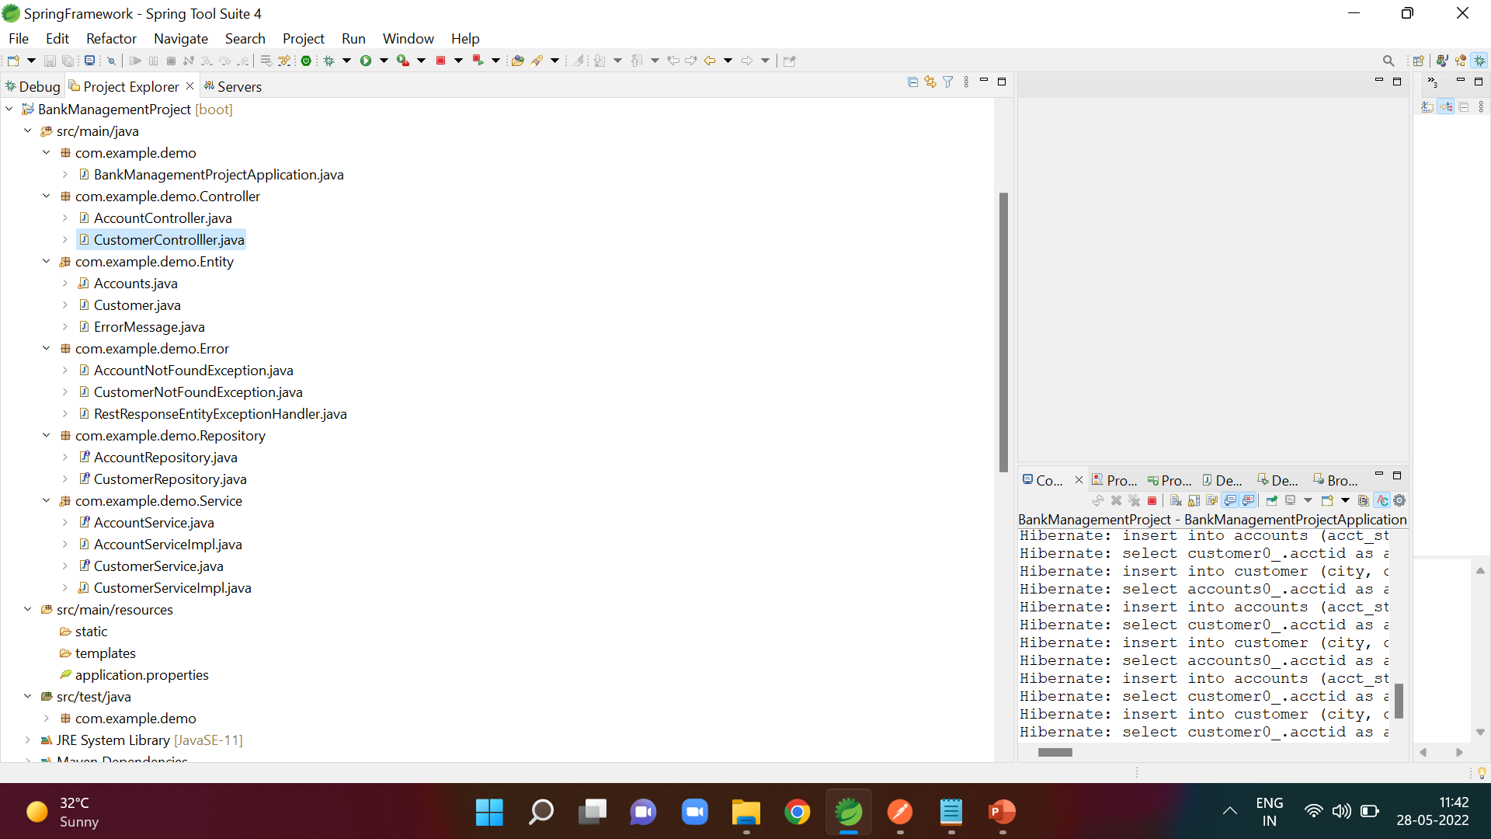

Slide 9
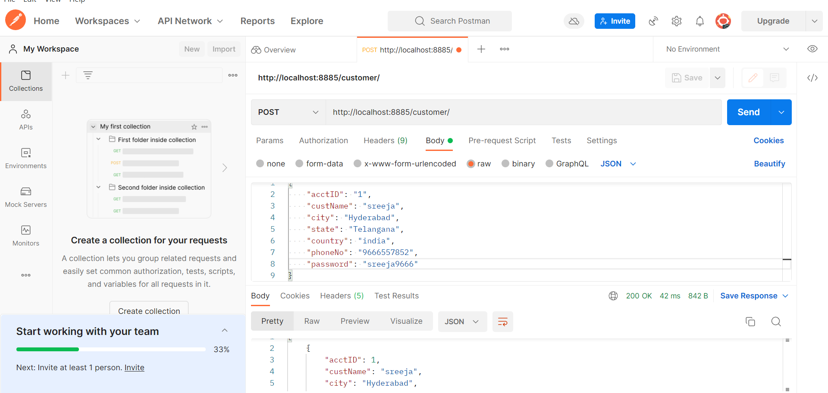
Inserting the customer details By Using POST Method
URL:http://localhost:8885/customer/

Slide 10
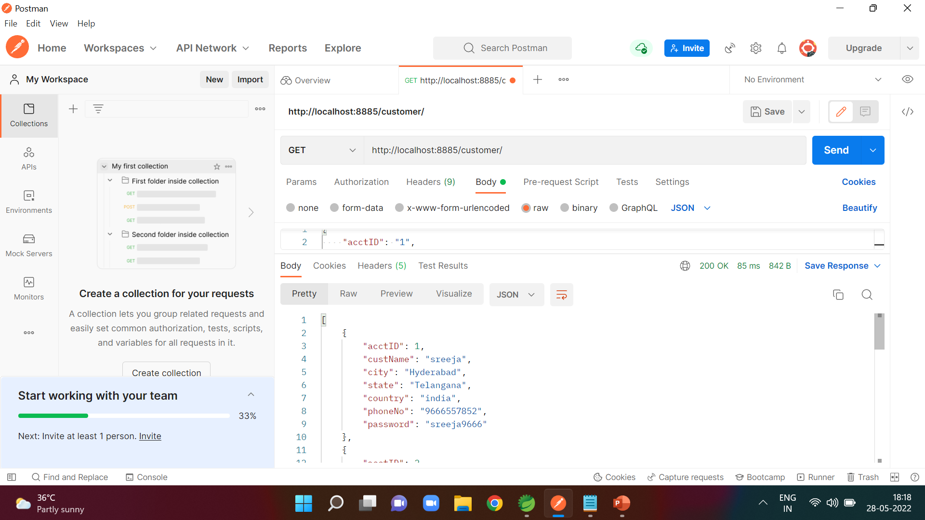
Display All details of Customer By Using GET Method
URL:http://localhost:8885/customer/

Slide 11
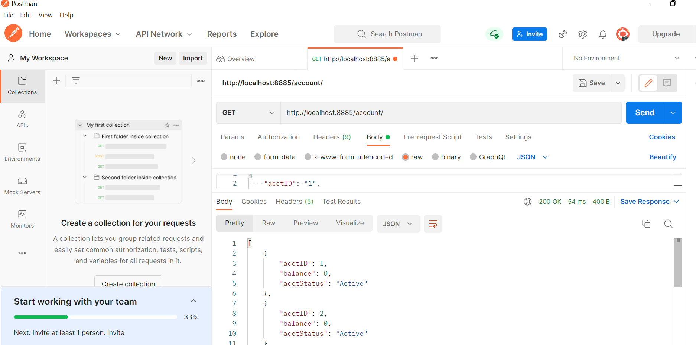
Display All details of Account By Using The GET method
URL:http://localhost:8885/account/

Slide 12
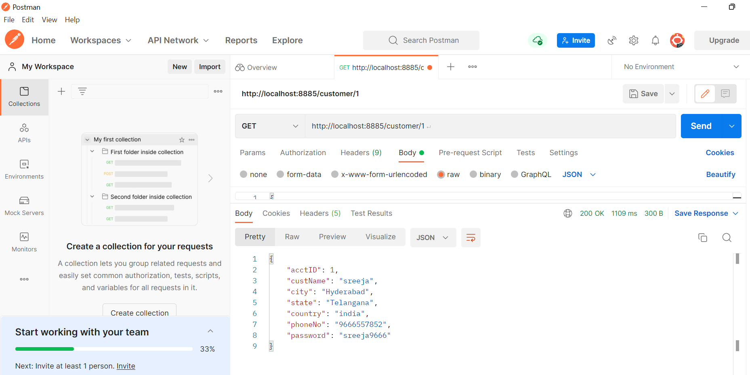
Display the details of customer based on id By using GET method
URL:http://localhost:8885/account/1

Slide 13
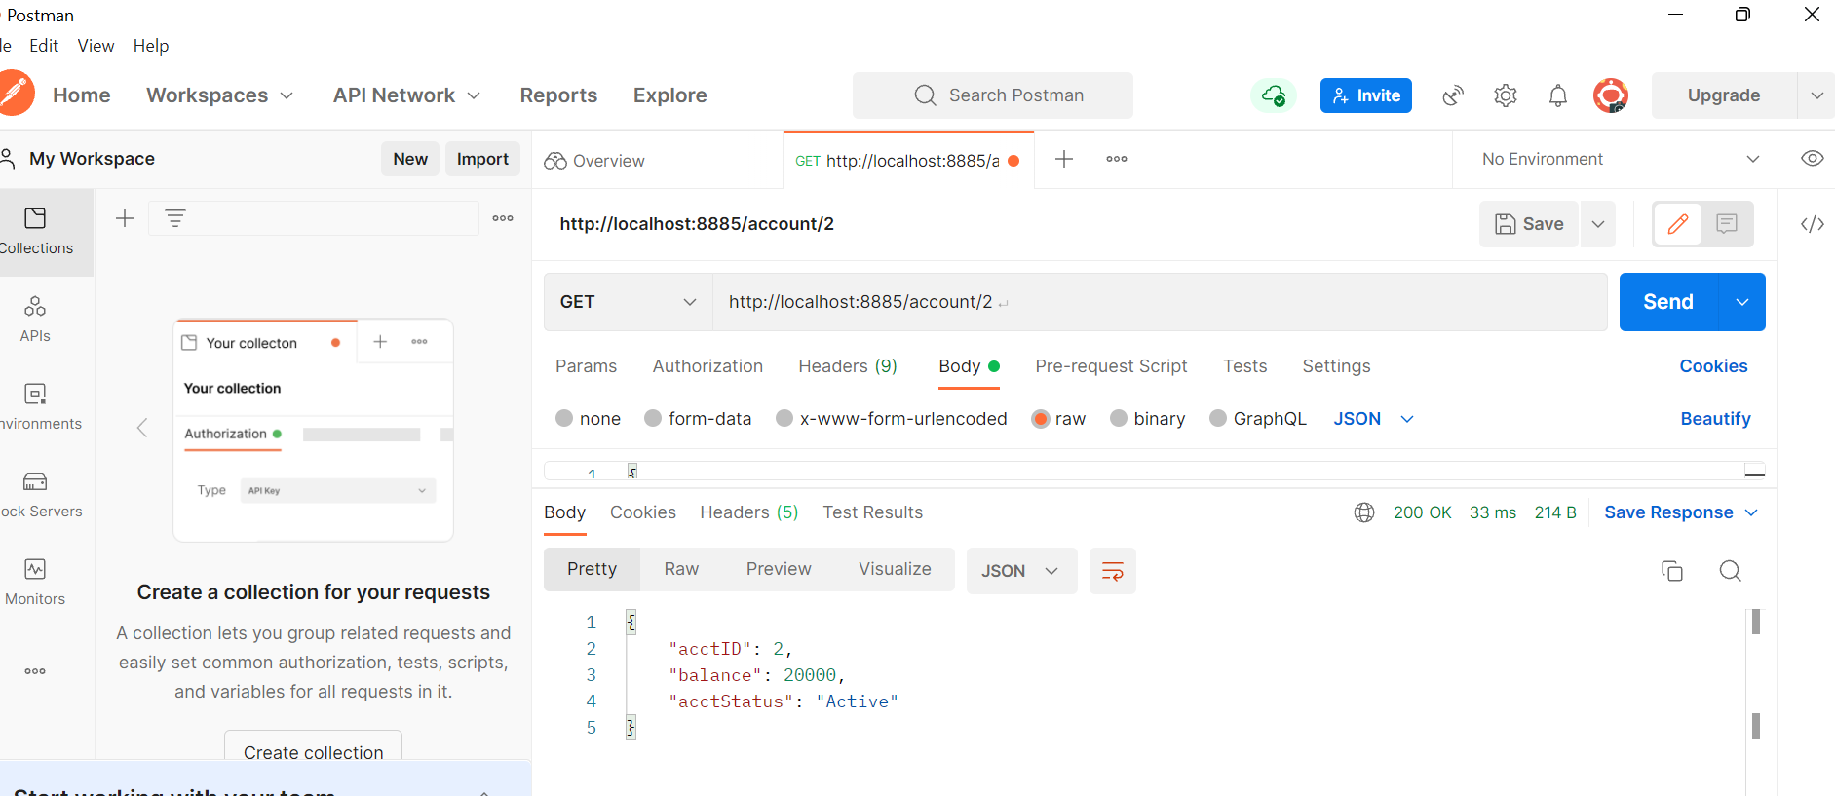
Display the details of customer Account based on id By using GET method
URL:http://localhost:8885/account/2

Slide 14
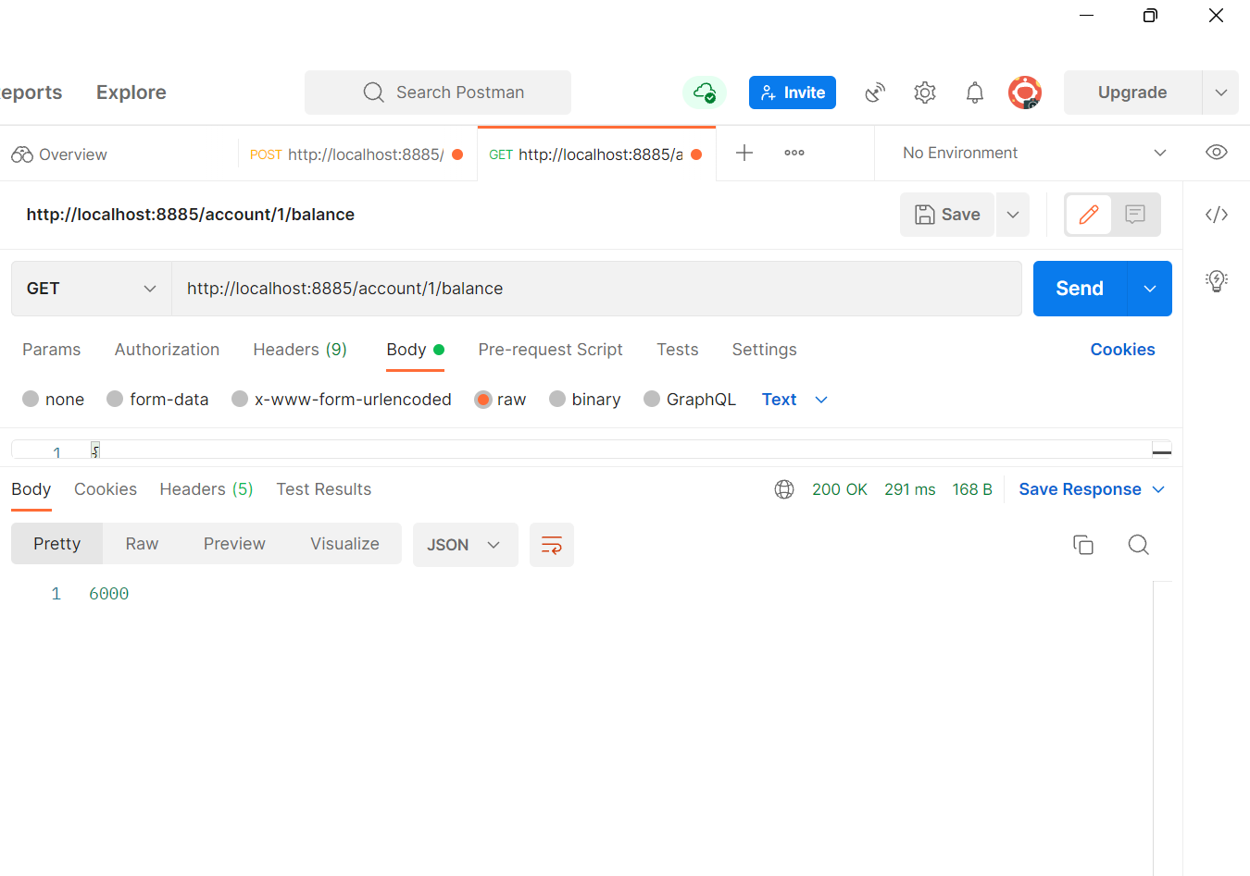
Display the balance of customer based on id By using GET method
URL:http://localhost:8885/account/1/balance

Slide 15
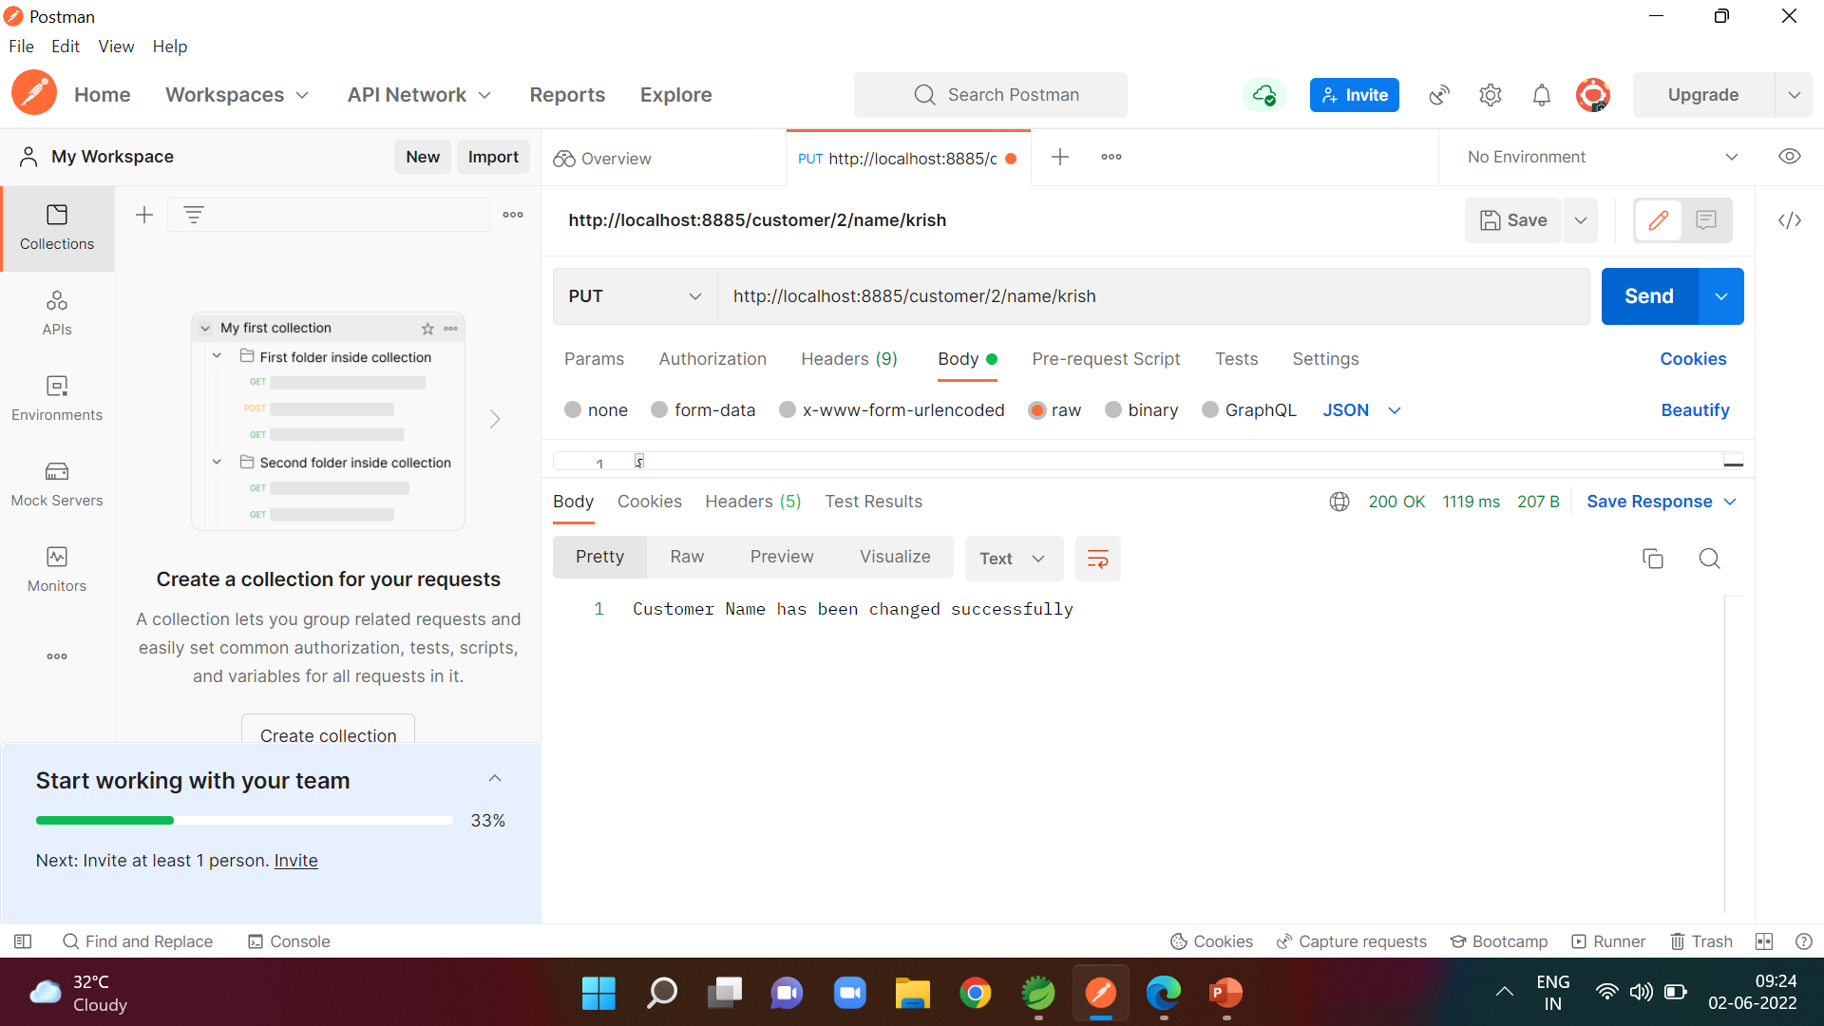
if Customer wants to Change His Name By using PUT method
URL:http://localhost:8885/customer/2/name/krish

Slide 16

if Customer wants to Change His City By using PUT method
URL:http://localhost:8885/customer/4/city/mumbai

Slide 17

if Customer wants to Change His State By using PUT method
URL:http://localhost:8885/customer/4/state/maharashtra

Slide 18

if Customer wants to Change His Phone Number By using PUT method
URL:http://localhost:8885/customer/3/phone/9456386215

Slide 19
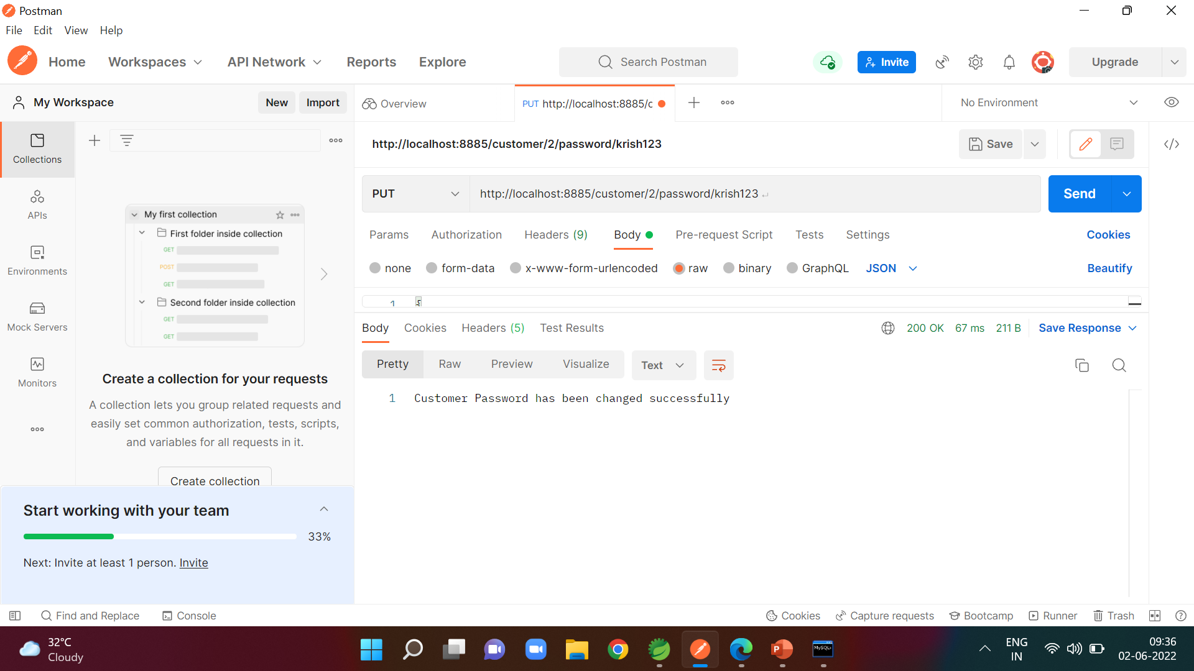
if Customer wants to Change His Password By using PUT method
URL:http://localhost:8885/customer/2/password/krish123

Slide 20
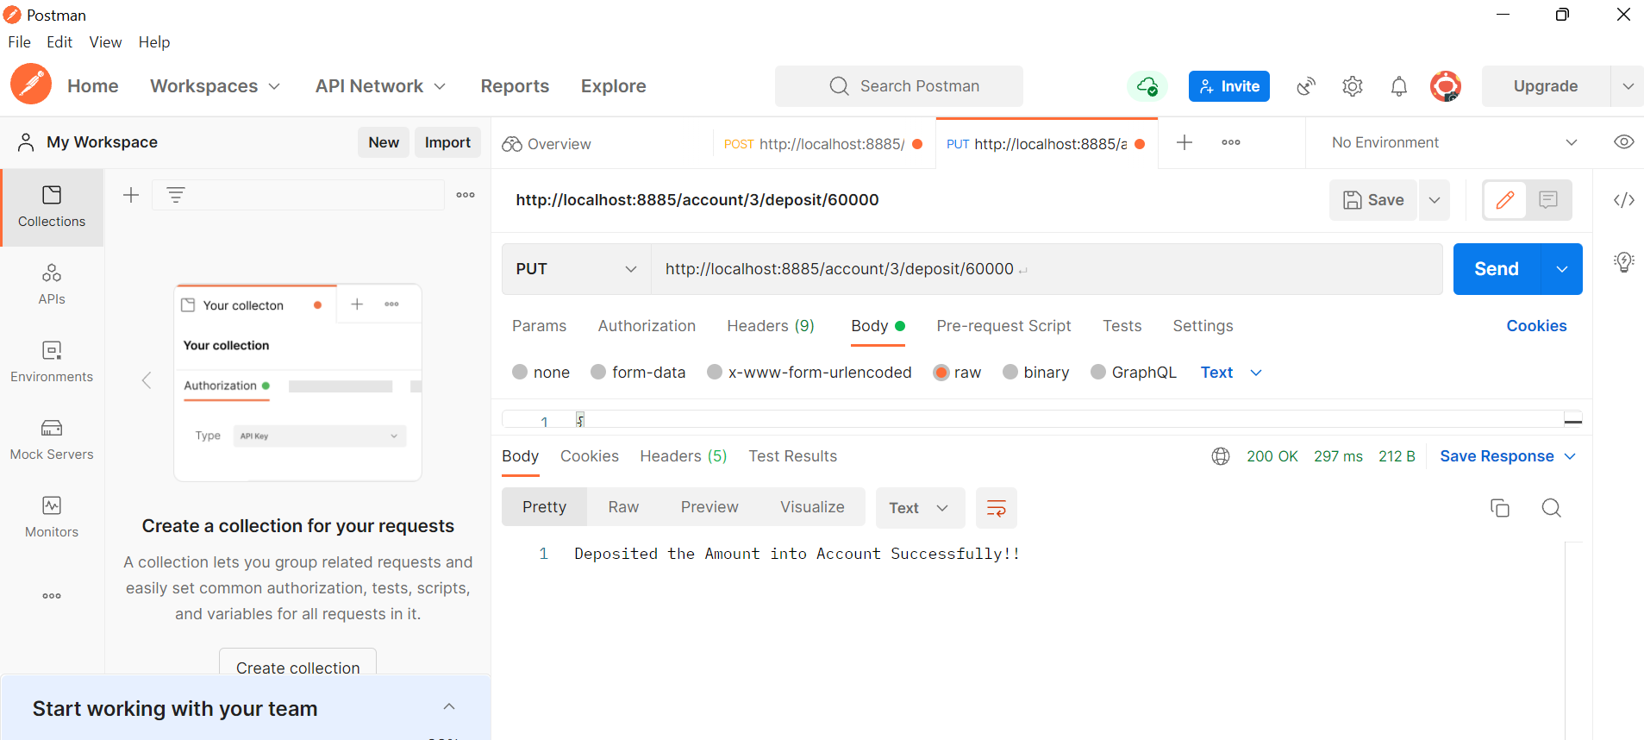
if Account Holder wants to Deposit some money into his Account By using PUT method
URL:http://localhost:8885/account/3/deposit/60000

Slide 21

if Account Holder wants to Withdraw some money into his Account By using PUT method
URL:http://localhost:8885/account/1/withdraw/5000

Slide 22

Account holder wants to transfer money into another account by using PUT method
URL:http://localhost:8885/account/1/transfer/5/2000

Slide 23
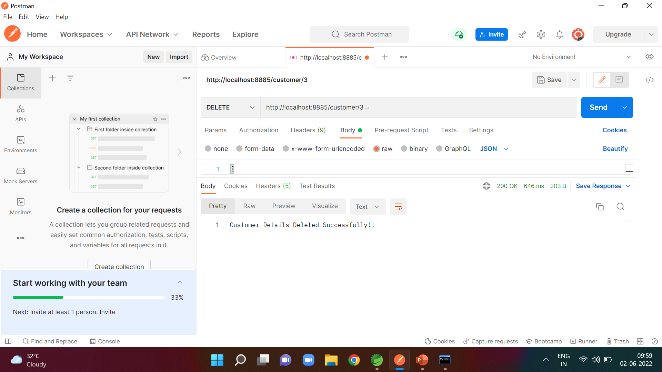
Deleting the customer details based on id By using DELETE method
URL:http://localhost:8885/customer/3

Slide 24
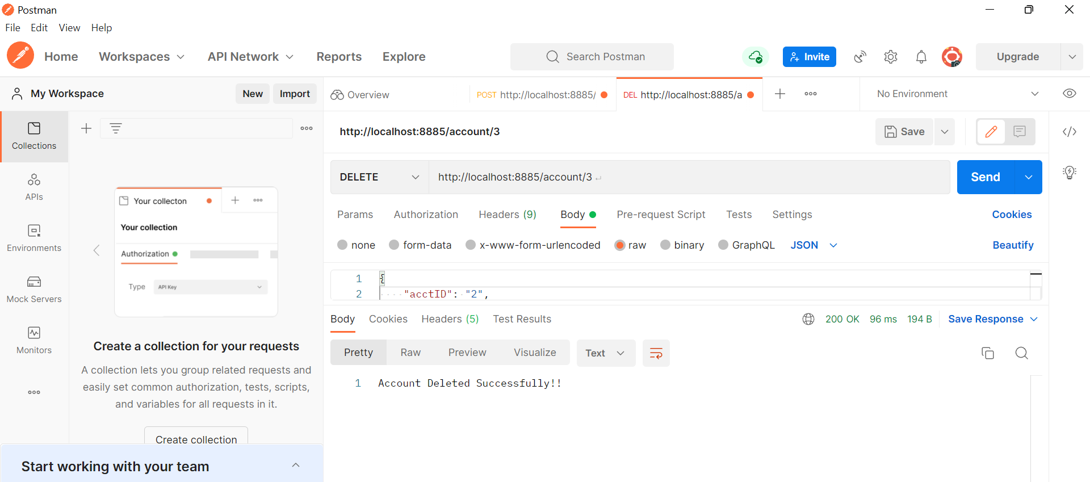
Deleting the account details based on id By using DELETE method
URL:http://localhost:8889/account/3

Slide 25
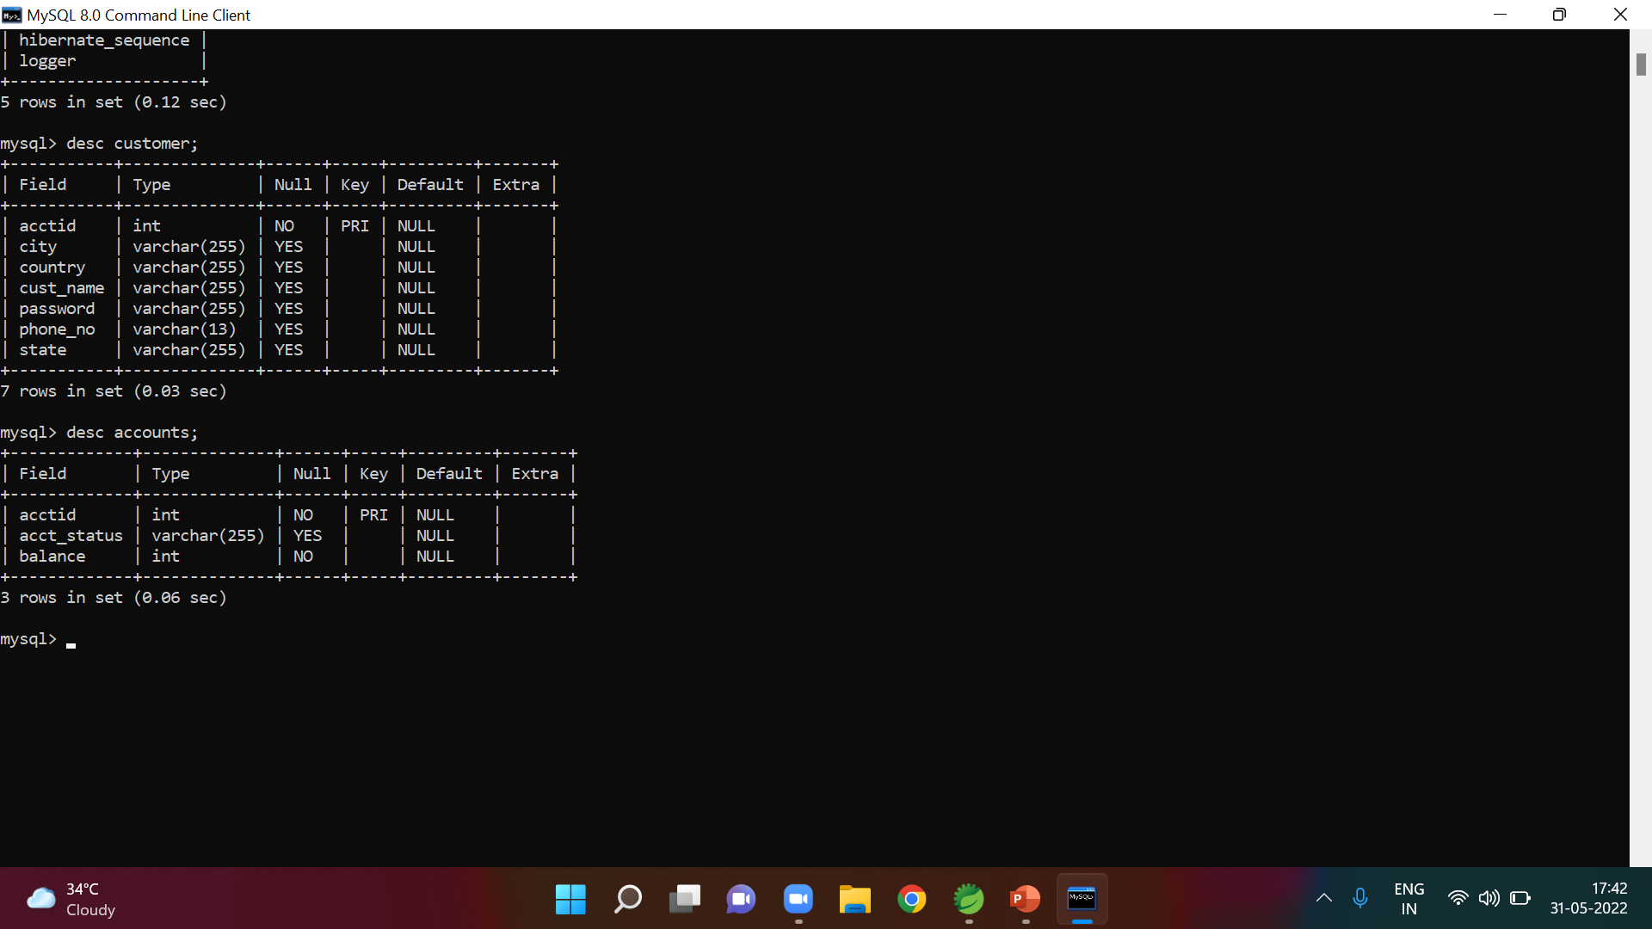
Customer and Account tables in Database

Slide 26
Conclusion:
This project is developed to nurture the needs of a user in a banking sector by embedding all the tasks of transactions taking place in a bank.

Slide 27
Thank You

